Slide 1
Why is the normal distribution everywhere?
Yusong Wang
Raghavendra Kommavarapu
Theo Kim
The importance of the Central Limit Theorem

Slide 2
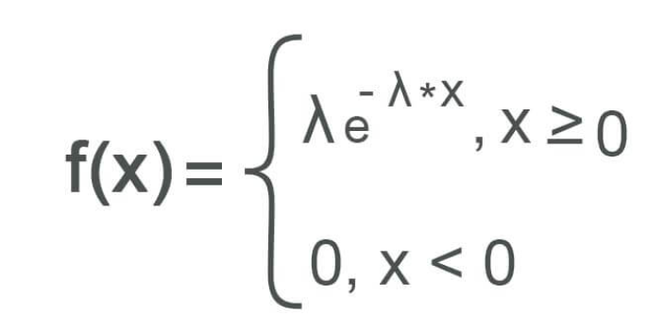
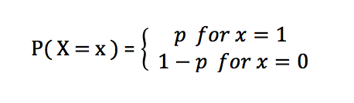
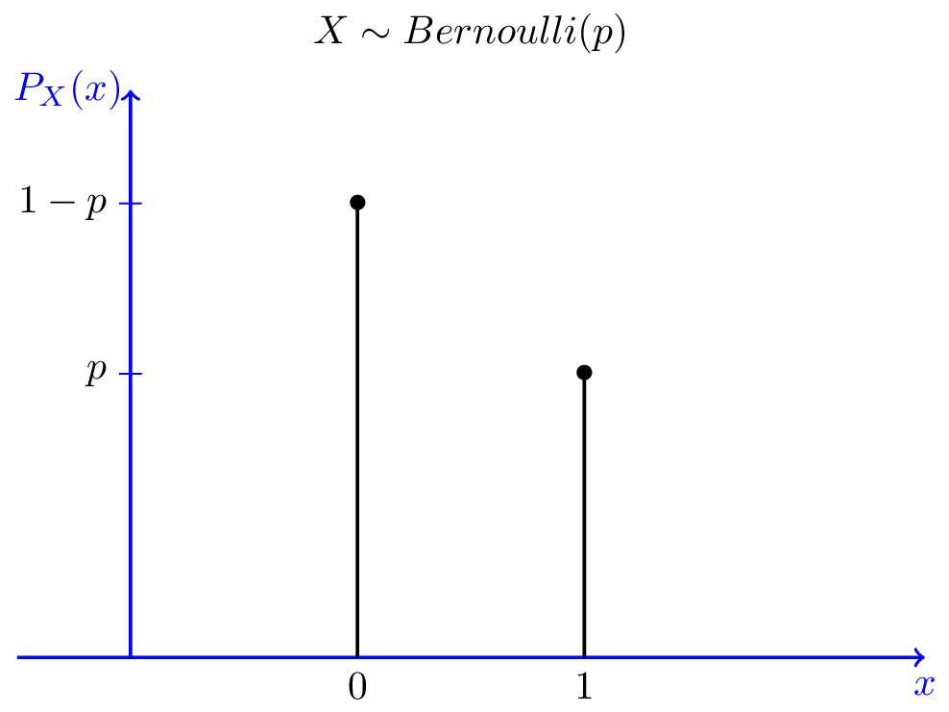

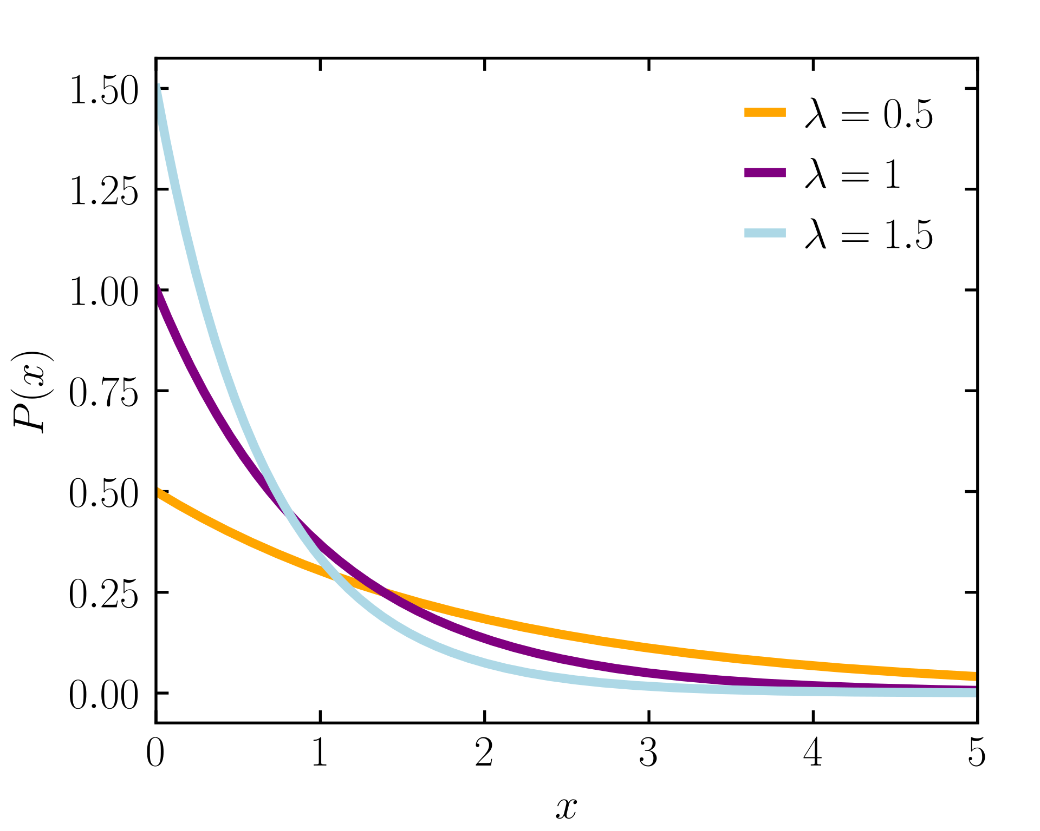
Let’s talk about distributions!
Mathematical function that gives the probabilities of occurrence of different possible outcomes

Slide 3
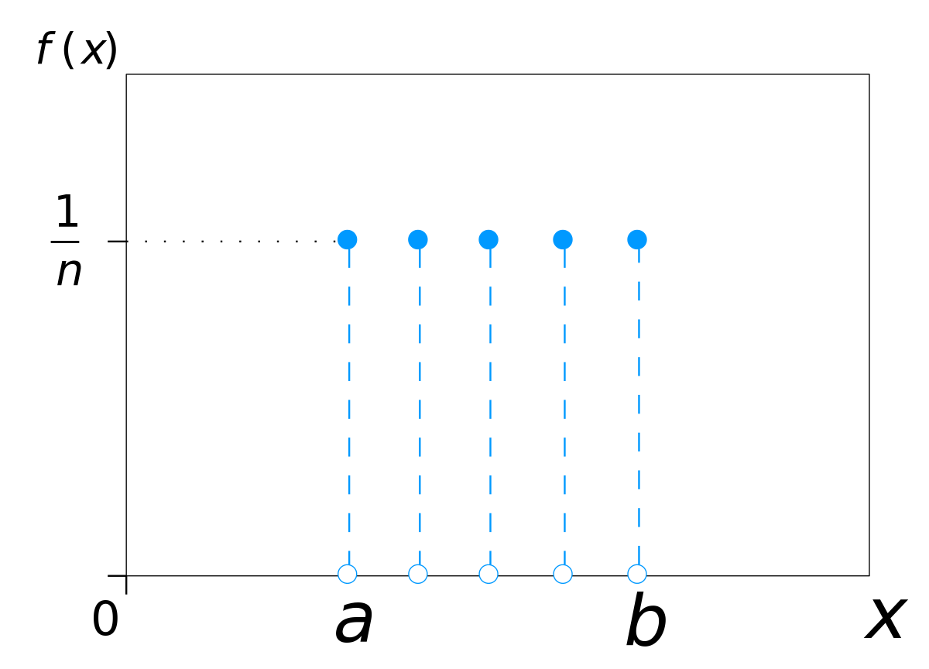
Uniform Distribution

Slide 4
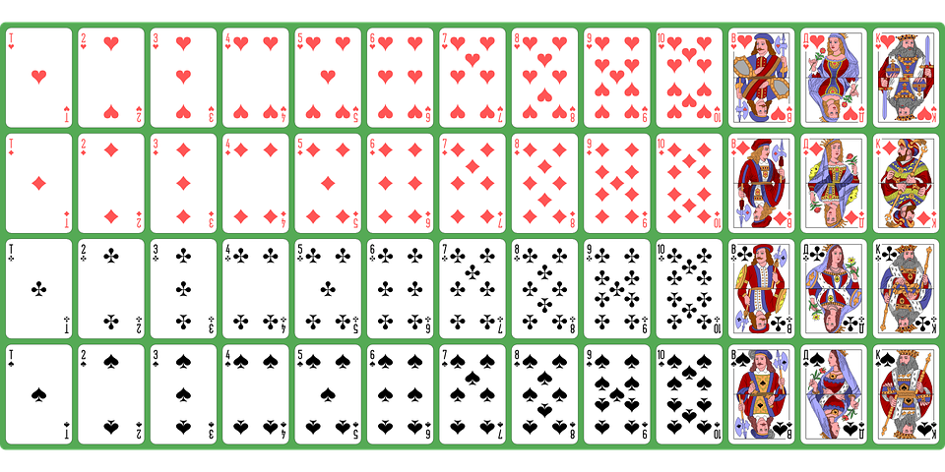
Uniform Distribution

Slide 5


Uniform Distribution

Slide 6
Bernoulli Distribution

Slide 7

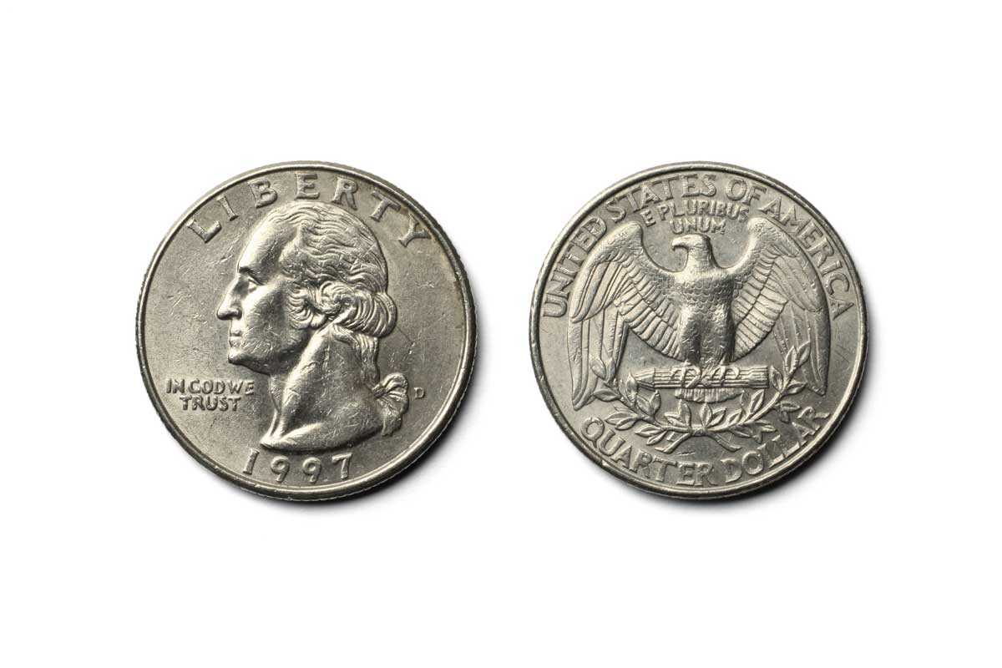
Bernoulli Distribution

Slide 8

Exponential Distribution

Slide 9
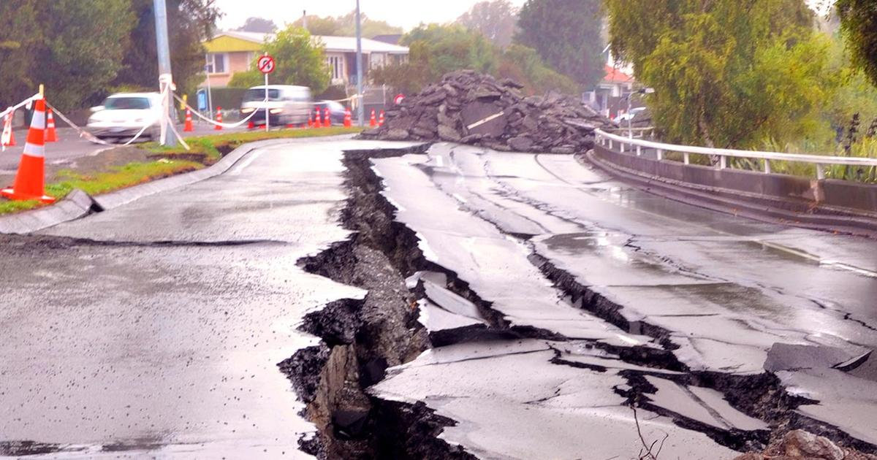
Exponential Distribution

Slide 10


Exponential Distribution

Slide 11
Exponential Distribution

Slide 12
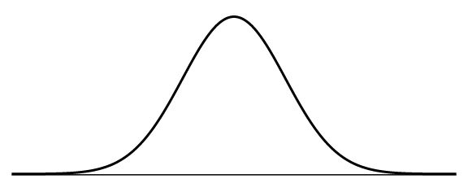
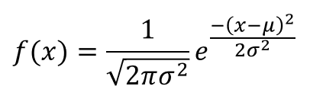
Normal Distribution

Slide 13

Normal Distribution

Slide 14
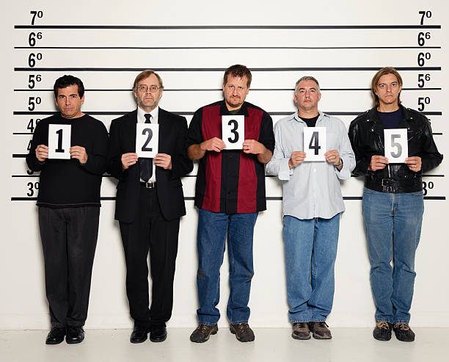
Normal Distribution

Slide 15

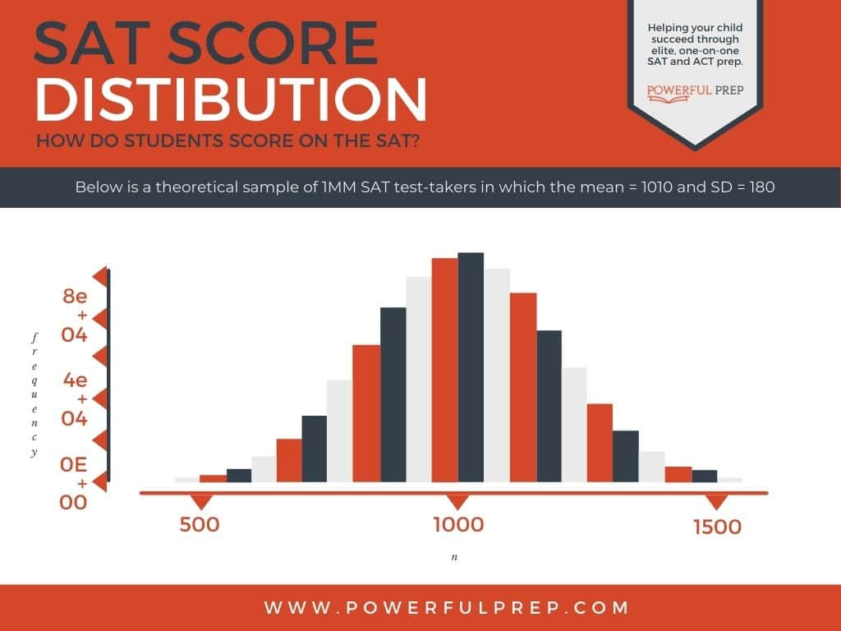
Normal Distribution

Slide 16
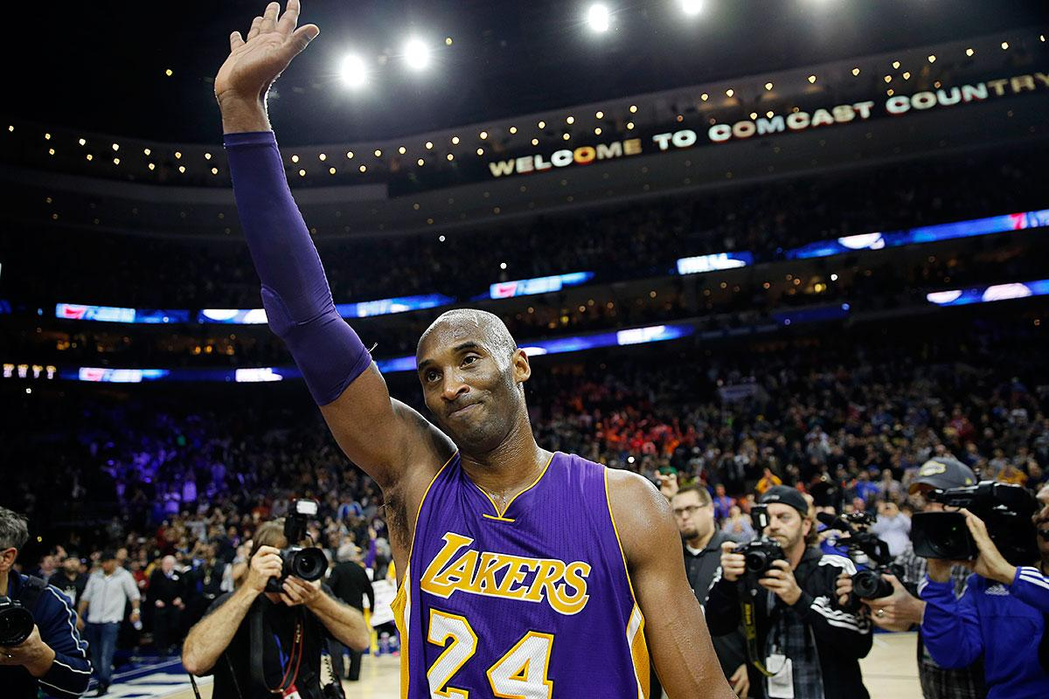
Normal Distribution
Notes:
Professional sports players’ retirement ages

Slide 17

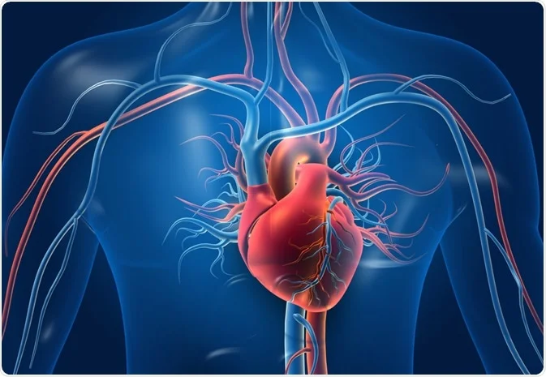

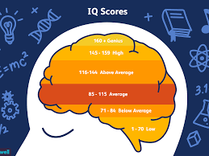
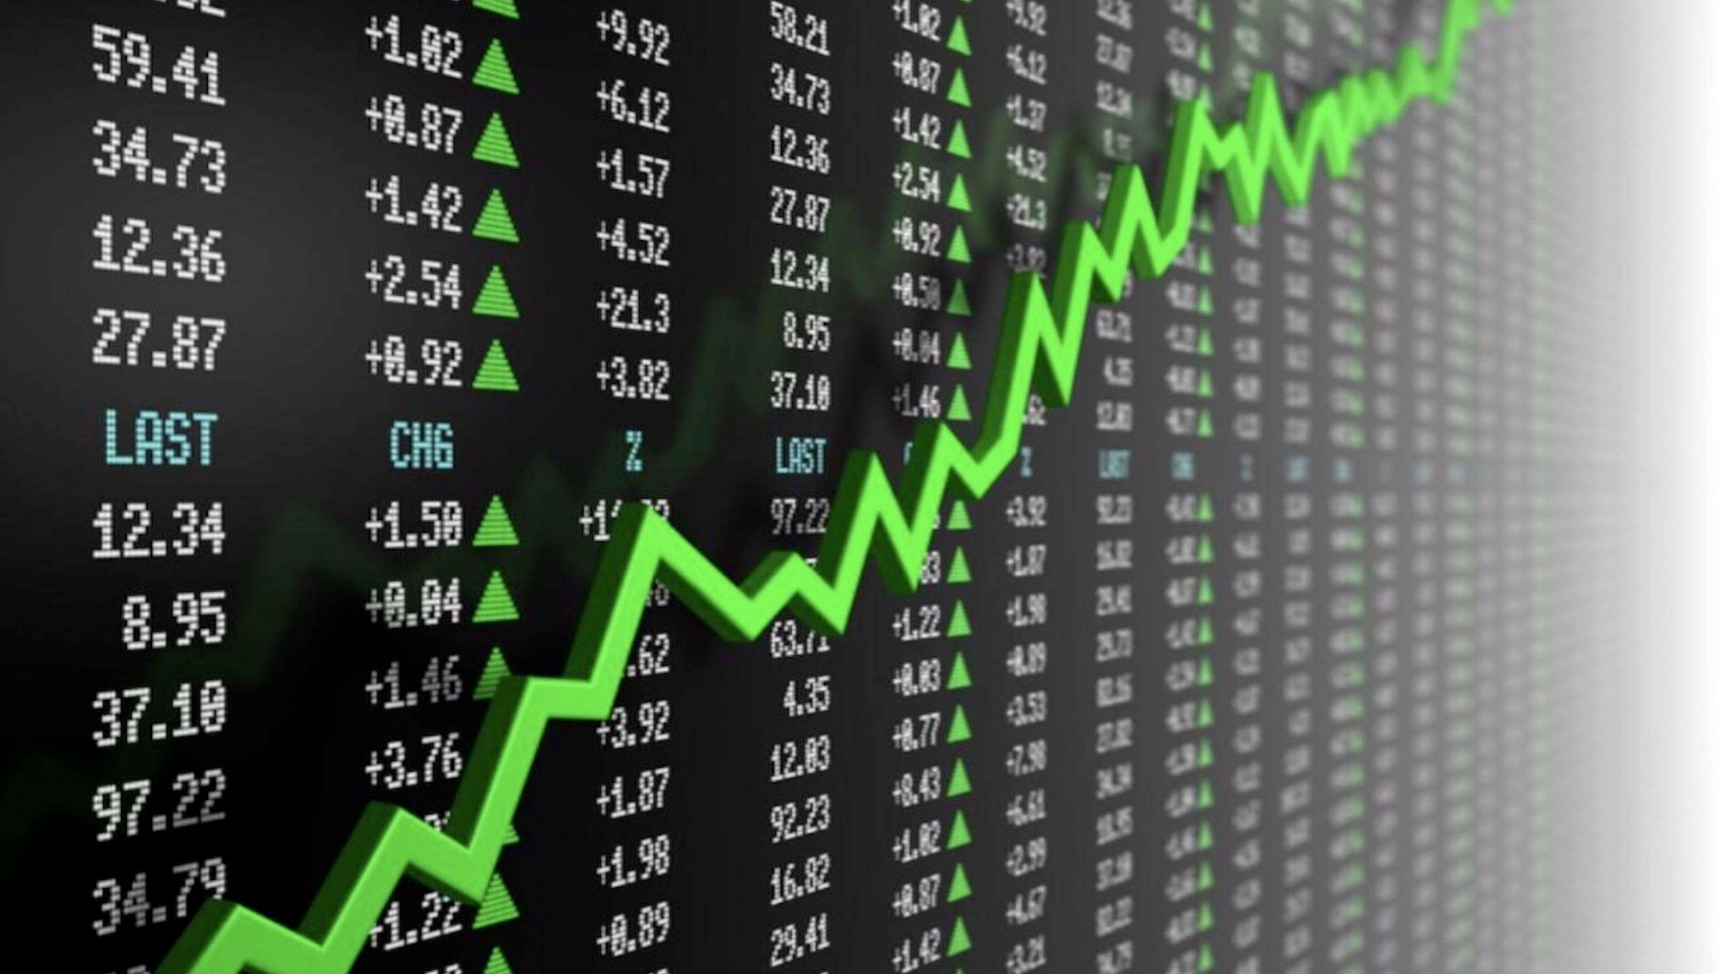
Normal Distribution
Notes:
Heart size, blood pressure, leaf size, shoe size, stock return, economic incomes, IQ scores
Lets now see why normal dist is prevalent

Slide 18
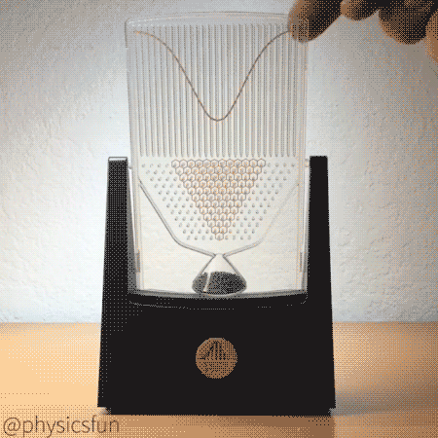
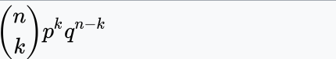
Interesting Case: binomial becomes normal
Binomial:
Notes:
As Theo mentioned about normal distribution prevalence,
let me start with an example to start explaining the prevalence of normal distribution
But C(n,k) / factorials takes a lot of effort to calculate so people started looking for easier understanding of distributions leading to discovery of DML theorem

Slide 19
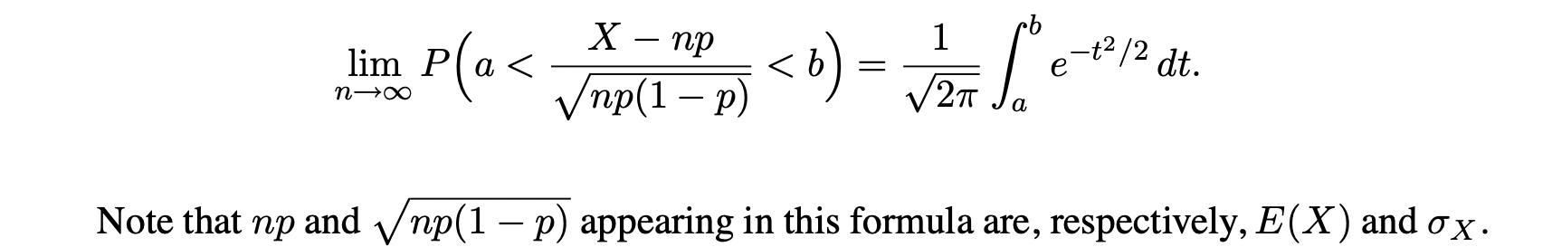
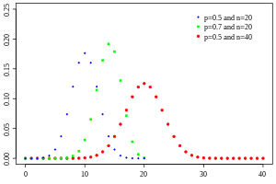
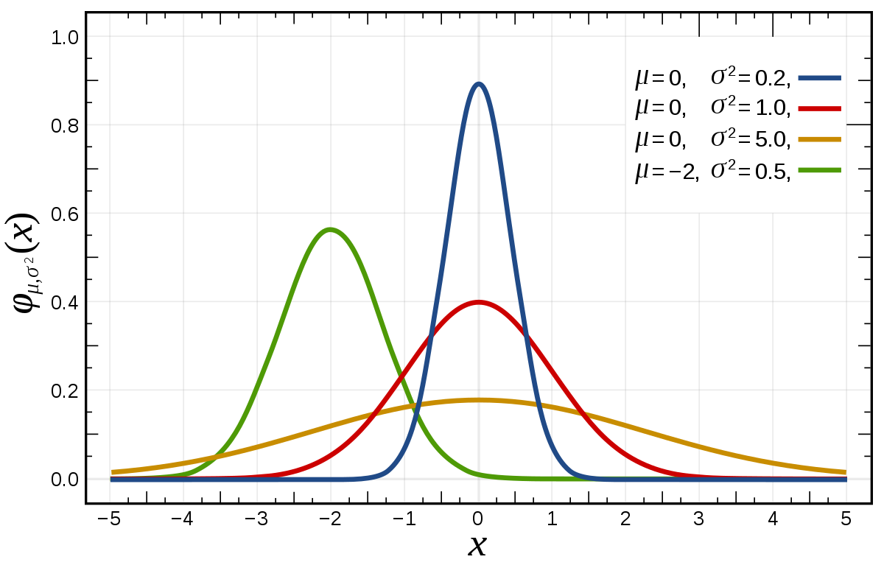
De Moivre-Laplace Theorem
Let X be a binomial random variable with parameters n and p. Then for any numbers a and b, a < b
Binomial
exp(-½((x-mu)/stdev)^2
Notes:
A theorem as old as 1738 !

Slide 20
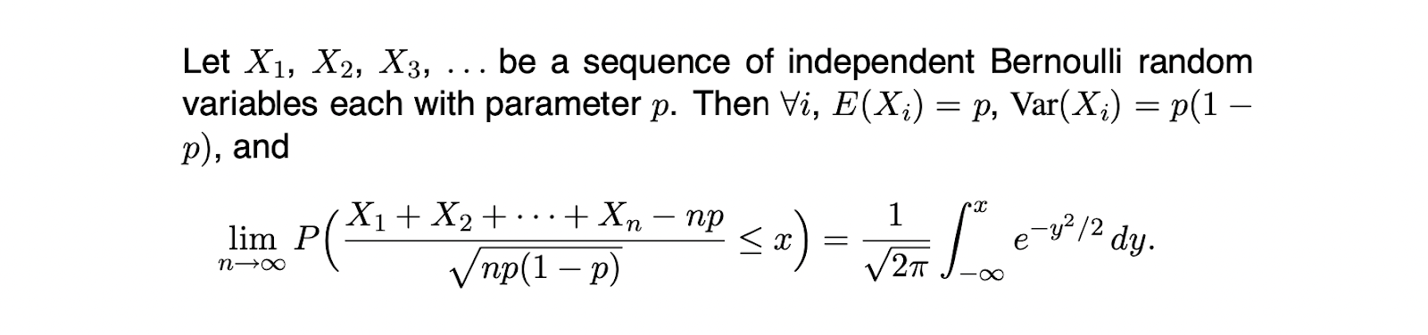
Motivation for generalization
Chebyshev, 1887
Markov,
Lyapunov, 1901

Slide 21
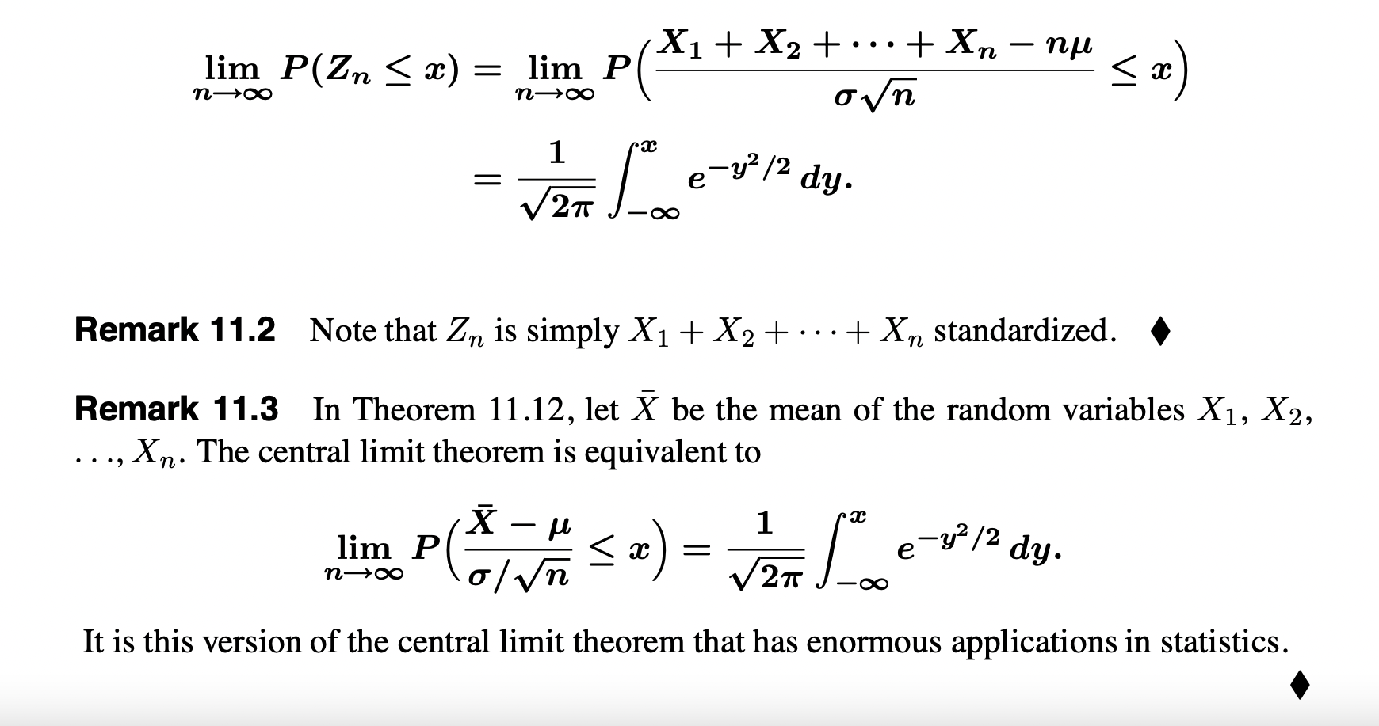
The Central Limit Theorem
Notes:
Published in 1920!

Slide 22
About the name
Normal
Gaussian
Bell-shaped curve

Slide 23
Remark and Notes
De Moivre-Laplace Theorem together with the generalization expressed the connection between addition of random factors and the phenomena seen by people.
Examples
What everybody decide to eat daily and the weight of that group of people
How the detection of radioactive elements in a time interval is contributed by a series of decisions which leads to being detected or not, for every single particle.

Slide 24
Question
Most of phenomena are bernoulli in macroscopic?
(it could be something else, to motivate the audience about the connection between randomness and macroscopic phenomenon and how the theorem in mathematics grabbed and summarized this nature successfully.)

Slide 25
Proof
They are shown to have the same Moment Generating Function
Moment Generating Functions:
Unique to a distribution
Used to calculate any order of the momentum

